Slide 1
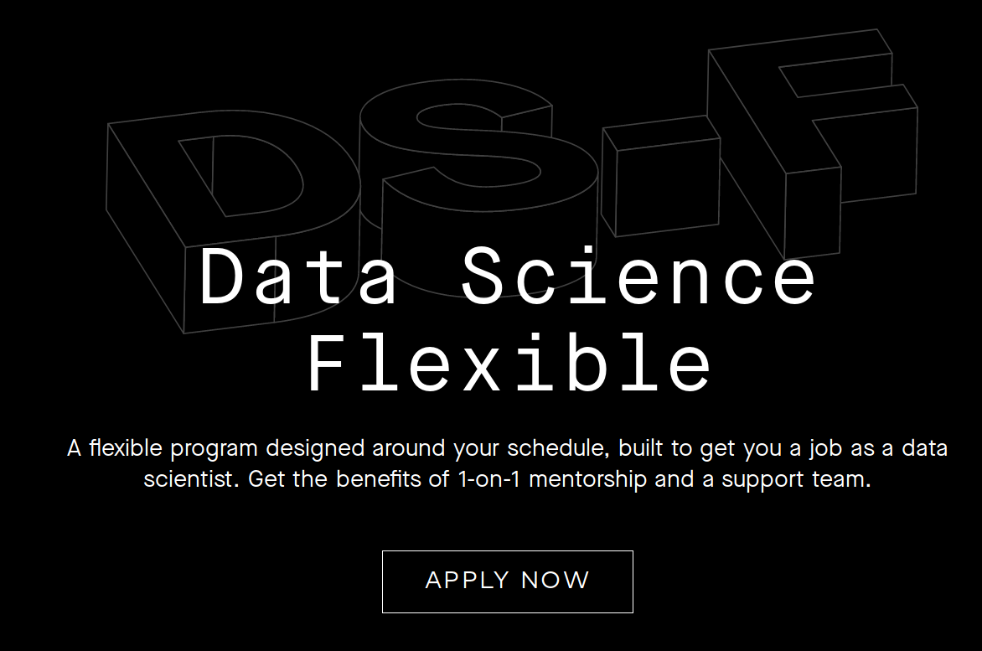

From Bootcamp to Data Scientist in 2019

Slide 2
Outline
Thinkful Data Science Bootcamp.
  Reviews & Comparisons
  Outcomes Report
  Job Guarantee
  Curriculum
  Mentor and Support
  Social Events
Career Services & Job Search
  Career Coach
  Job Market
Other Resources
  MOOCs

Slide 3
What are “Coding Bootcamps”?
A coding bootcamp is a technical training program that teaches the programming skills that employers look for.
Infographic1: Coding Bootcamp vs CS Degree
Infographic2: Bootcamp Outcomes

Slide 4
Thinkful’s Data Science Bootcamp
About Thinkful
Data Science Flex Program
Comparisons and Reviews
  SwitchUp and CourseReport
Outcomes Report for Data Science. Also, CIRR.ORG
Tuition Reimbursement Guarantee: Requirements.pdf
Curriculum- Log In

Slide 5
My Experience
Mentor: 6.5/10
Slack Support with Curriculum: 10/10
Q&A Sessions: 10/10
Social Events: 8/10
Career Services
  Careers Curriculum: 9/10
  Coach: 8/10
  Employer Partnerships: ?

Slide 6
Job Market
Demographics of a Data Scientist in 2019
Angellist report on LA tech scene.
Linkedin report on Data Science 2018.
IBM report: Demand for DataSc & Analytics Workforce.
StackOverflow Developer Survey 2018.

Slide 7
Angellist Report- Summary
72% of LA’s software engineering grads leave LA for their first job.
Quote “We have to be more accomodating to new engineers...”(pg. 7)
Attrition: The problem of hiring only Senior-level talent.(pg. 12)

Slide 8
Linkedin Report- Summary
Cities with the highest shortages of data science skills.

Slide 9
IBM Report- Summary
Data Scientist roles require more advanced degrees as minimum qualifications. (page 7)
Data Scientist roles are the most “disruptive”.(page 15)
Data Scientists have the highest (39%) expected growth among analytics professionals.(page 21)
  43% of postings require Master’s or higher.

Slide 10
StackOverflow Survey- Summary
Women are more likely to be Data Professionals.
  Section: Developer_Profile.V.Demographics
Data Scientists have less experience than other roles.
  Section: Developer_Profile.III.Experience
Data Scientists are more likely to be looking for a job.
  Section: Work.V.Looking for a job
Data Scientists earn more than others in relation to experience.
  Section: Work.VIII.Salary

Slide 11
Greek Persuasion for the Job Search
Ethos: Ethical appeal. Appropriate language and vocabulary, making yourself sound fair or unbiased, introducing your expertise, accomplishments or pedigree, and by using correct grammar and syntax.
Pathos. Emotional appeal. Using meaningful language, emotional tone, emotion evoking examples, stories of emotional events, and implied meanings.
Logos. Appeal to logic. Using advanced, theoretical or abstract language, citing facts, using historical and literal analogies, and by constructing logical arguments.

Slide 12
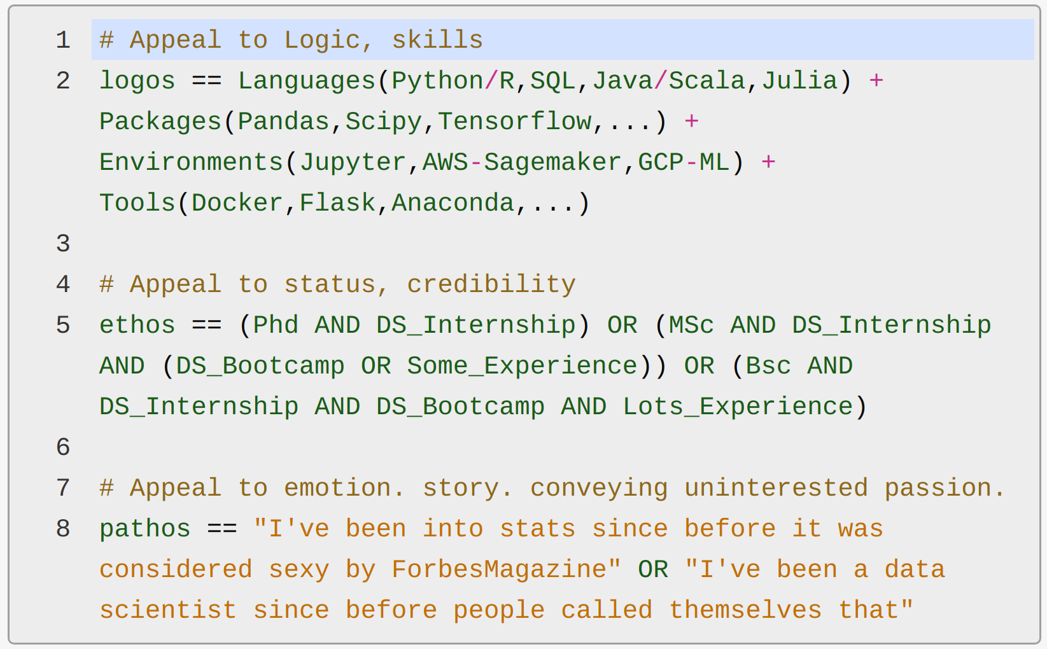
My Formula to be a Data Scientist

Slide 13
The Ultimate “pathos” in Data Science
Interview with Kaggle Grandmaster, Senior Computer Vision Engineer at Lyft: Dr. Vladimir I. Iglovikov
Summary:
Theoretical physics Phd, learned Data Science online a few months before graduation when visa was expiring. First job after Phd: “Data Scientist” (Oct 2015).
Quote illustrating pathos
“A big tech company, Mail Ru Group, agreed to pay me the prize money, it was $15k, but I did not feel that I deserve them, so I asked to transfer them to a fund that supports theoretical Physics.”

Slide 14
Closing notes
Formal education credentials are the biggest gatekeepers for data science jobs, but this barrier is gradually disappearing due to ds bootcamps.
Make sure whatever you study has a “Ethos” attached to it. (Sorry books)
  Bootcamps have good reputations and look good as resume experience.
  MOOCs: Edx, Coursera.
  Online Masters in Data Science (Self-paced) for $20k
If you’re interested in a course/ bootcamp, try not to leave your current job. The best time to look for a job is when you have a job.
If not a job, a bootcamp may server as a bridge toward a master’s in data science, after which your non-technical college major won’t be an impediment.
A job as a data analyst is proven path to later becoming a data scientist.

Slide 15

Happy Analyzing
Miguel Niblock
miguelniblock@posteo.net
www.linkedin.com/in/miguelniblock
www.github.com/miguelniblock

